Slide 1

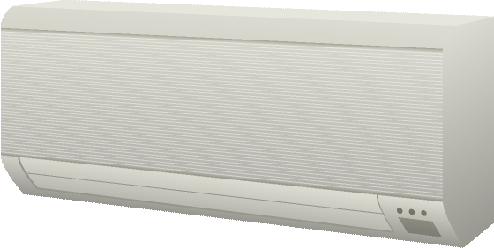

Electronic appliance
Remote controller

Slide 2
Remote controller
Electronic appliance
Remote controller

Slide 3
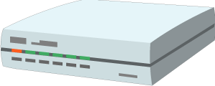
Home hub
Browser or application
Electronic appliance

Slide 4
Proxy
Browser or application
Electronic appliance

Slide 5
agent
Home hub
Browser or application
Electronic appliance

Slide 6


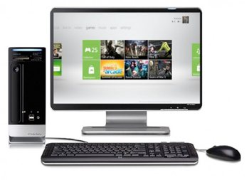


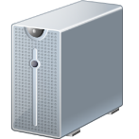
Factory
Services
Monitor
RS-485
EtherCAT

Slide 7
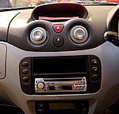


Services
DCU
Gateway
CAN
ECU
CAN
ECU
ECU

Slide 8

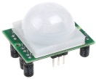
Control
agent

